Slide 1
MITUL GADA & ASSOCIATES
Group 1
Ankita Wadhwa
Bhavisha Mehta
Geethika Veluri
Manoj Thadani
Rounak Burad
Sanskruti Jain

Slide 2
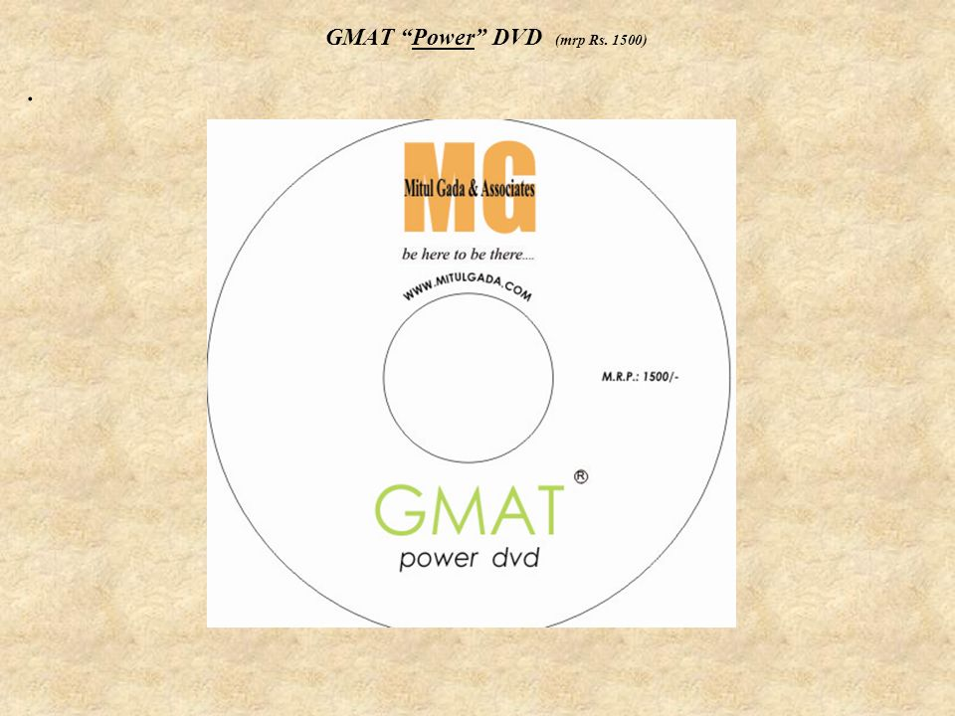
CLIENT OVERVIEW
Based in Mumbai, India
Started in the year 2008
Test prep provider for GRE, GMAT, SAT, LSAT, ACT, IB, SSAT
GMAT students with 700+ scores in Mumbai
Mitul’s USP lies in his unique teaching method where the emphasis is given on the concepts in depth rather than theory

Slide 3
GOOGLE ADWORDS

Slide 4
ACCOUNT STRUCTURE
Mitul Gada & Associates
Graduate and Business Entrance Exams
GRE
Other Exams
SAT
Account
Campaign
Ad Groups
+Gmat coaching in Mumbai , +gmat courses +near +me, best classes for gmat in mumbai
Keywords
gre class near me, gre classes in Mumbai, gre practice course
GMAT
SAT coaching in Mumbai, sat test prep
LSAT
IB,SSAT
LSAT entrance preparation, LSAT tutor
ACT test classes, IB test entrance preparation
Notes:
Add key words here

Slide 5
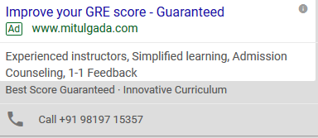
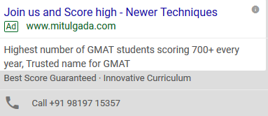
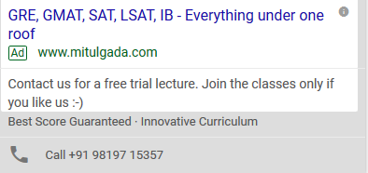
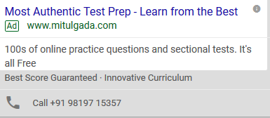
SAMPLE ADS

Slide 6
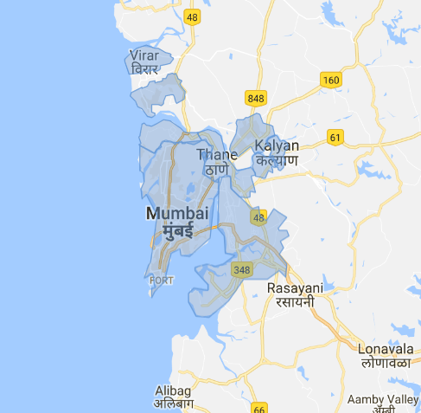
TARGET AUDIENCE
Location
Mumbai, Thane, Navi Mumbai
Age Groups
18-24 : 289
25-34 : 215
Gender
Male : 406
Female : 294
Kalyan, Vasai, Virar, Bhiwandi
Others: 238
Unknown: 348
Unknown : 306

Slide 7
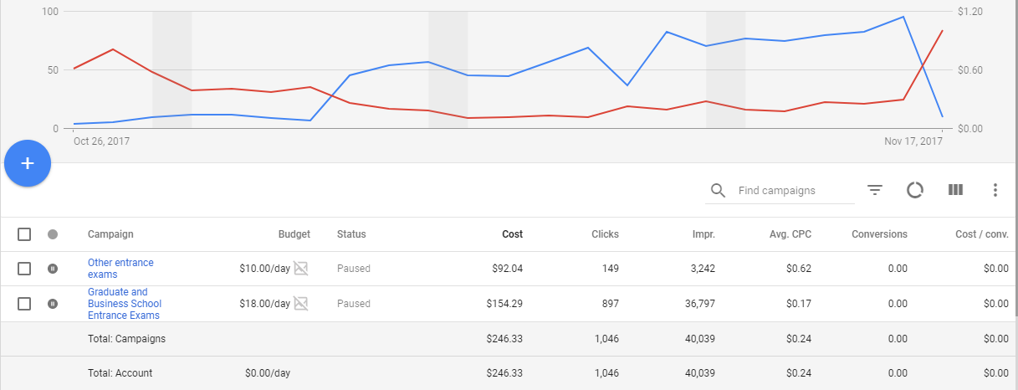
CAMPAIGN INSIGHTS
Graduate and Business School Entrance Exams
36,797 impressions
897 clicks
2.44% CTR
Other Entrance Exams
3242 impressions
149 clicks
4.60% CTR

Slide 8
WEEKLY CHANGES
Week 1
Budget Allocated : 20%
Method Used : CPC, automatic bidding strategy
Broad match for all keywords
Used call extensions & call out extensions for the Ads
Campaign | Impressions | Clicks | CTR | Amount Spent
Graduate and Business school entrance exams | 1469 | 43 | 2.93% | $23
Other entrance exams | 824 | 37 | 4.49% | $16

Slide 9
Week 2
Budget Allocated : 30%
Review extensions, call extension & call out extensions added to improve ad quality
Paused keywords which gave less impressions and low CTR
New keywords added, used keywords suggested in opportunity tab
Added review extensions to the Ads
Campaign | Impressions | Clicks | CTR | Amount Spent
Graduate and Business school entrance exams | 17,506 | 339 | 1.94% | $46
Other entrance exams | 496 | 31 | 6.25% | $14

Slide 10
Week 3
Budget Allocated : 50%
Added possible negative keywords
Paused keywords which gave less impressions and low CTR
New keywords added, used keywords suggested in opportunity tab
Campaign | Impressions | Clicks | CTR | Amount Spent
Graduate and Business school entrance exams | 12,993 | 430 | 3.31% | $68
Other entrance exams | 1,364 | 60 | 4.4% | $41

Slide 11
Week 4
Manual Bidding for the keywords which were below the minimum first bid amount
Optimized keywords based on their performance by changing their match type
Match type was changed to phrase match for selected keywords
Campaign | Impressions | Clicks | CTR | Amount Spent
Graduate and Business school entrance exams | 4,829 | 85 | 1.76% | $21
Other entrance exams | 558 | 21 | 3.76% | $18

Slide 12
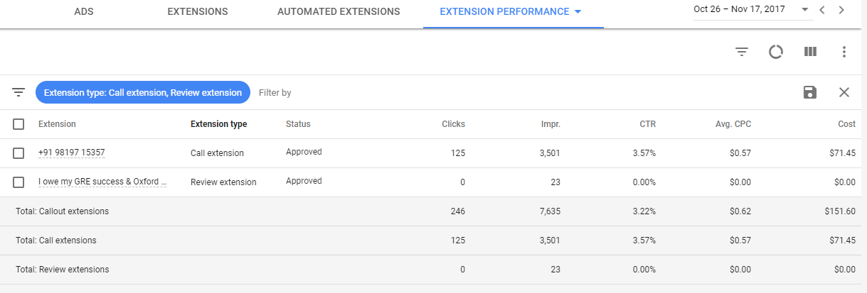
AD EXTENSIONS
Students call and read reviews related to the institute

Slide 13
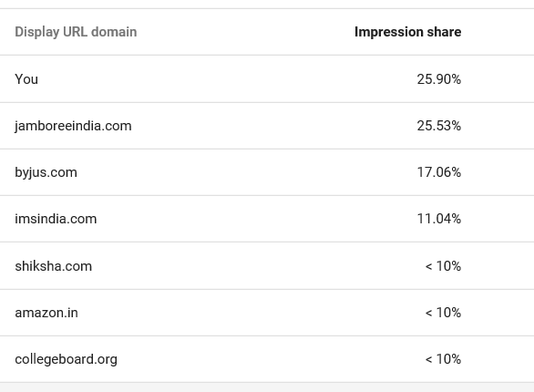
AUCTION INSIGHT
Our campaign outranked
the competitors in
impression share.

Slide 14
INFERENCES and RECOMMENDATIONS
Positives
Negatives
What could have done better
Achieved >1000 clicks
GRE & SAT groups achieved good results
GMAT Ad group did not perform well
Conducting a separate campaign for GMAT

Slide 15
Inferences and Recommendations
INFERENCES and RECOMMENDATIONS
Recommendations to the client
Conclusion
Continue Adwords campaign
Use google analytics to analyze the metrics
Make website more user friendly
Campaign was successful and we could increase the brand awareness of Mitul Gada & Associate through this Online marketing

Slide 16
FACEBOOK

Slide 17
ACCOUNT STRUCTURE
Mitul Gada & Associates
Traffic GRE
GRE/ GMAT
Traffic SAT
Account
Campaign
Ad Sets
SAT/ACT/ LSAT/IB/ SSAT

Slide 18

CAMPAIGN GOALS
Create Awareness : Increase number of visitors
2 Campaigns : 1 Ad set each
Budget Split : 60-40 among 2 Ad sets ; 40-60 for 2 weeks
Location : Desktop right column

Slide 19

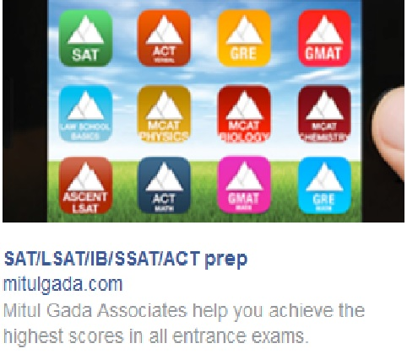
SAMPLE ADS

Slide 20
CAMPAIGN INSIGHTS
GRE/GMAT
Link Clicks | Reach | Impressions | Cost per result | Total amount spent
209 (Unique: 185) | 33,994 | 91,991 | 0.28 | 58.95
SAT/ACT/LSAT/IB/SSAT
Link Clicks | Reach | Impressions | Cost per result | Total amount spent
161 (Unique: 137) | 21,089 | 58,987 | 0.24 | 39.43

Slide 21
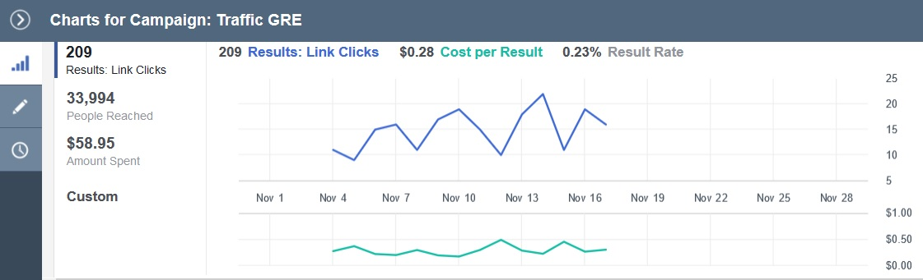
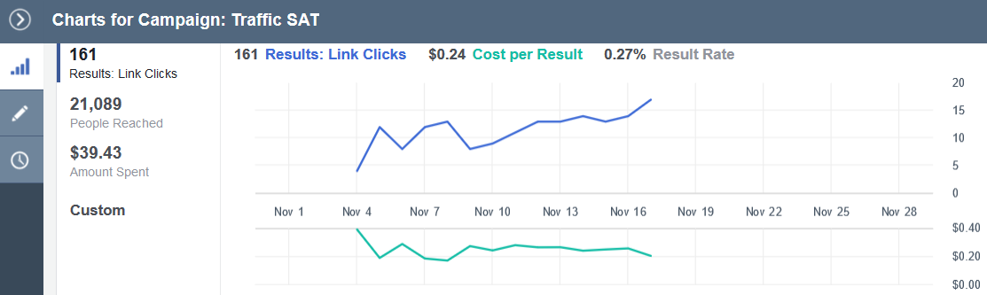
PERFORMANCE CHART

Slide 22
CHANGES AND RESULTS
Daily Budget
Changes
Observations
Ad set : GRE/GMAT 3.42$ - week 1 5.14$ - week 2
Ad set : SAT/ACT/LSAT/IB/SSAT $2.42 - week 1 $3.42 - week 2
Budget
Ad Content
Increase in reach and impressions
Led to increase in link clicks

Slide 23
INFERENCES and RECOMMENDATIONS
Positives
Negatives
Recommendations
Conclusion
High reach and number of impressions
Number of link clicks
High frequency : 2.7
To create a Facebook page
Use Facebook ads to increase awareness
Based upon the performance of the ads we could conclude that the campaign was a success since the results were satisfactory

Slide 24
ADWORDS vs FACEBOOK
Biggest difference between the two is Search Intent
Specifically looking for something
Marketing Strategy
Ads are shown based on their interest
Brand awareness

Slide 25
THANK YOU!

Slide 26


